Slide 1
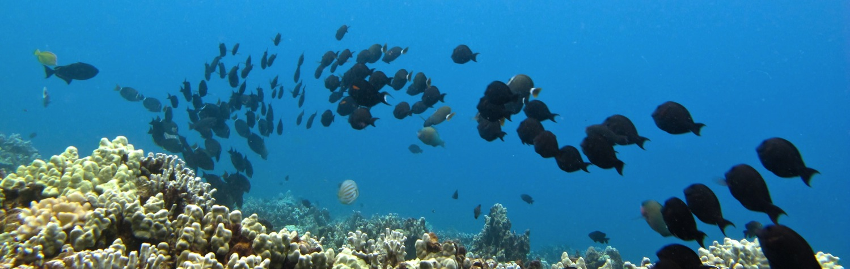
Herbivore Enhancement as a Tool for Reef Restoration
Emily Kelly
Center for Marine Biodiversity and Conservation, Scripps Institution of Oceanography, University of California San Diego
Russell Sparks
Division of Aquatic Resources, Hawaii Department of Land and Natural Resources
Ivor Williams
Coral Reef Ecosystem Division, National Marine Fisheries Service, NOAA
Jennifer Smith
Center for Marine Biodiversity and Conservation, Scripps Institution of Oceanography, University of California San Diego
1
1

Slide 2
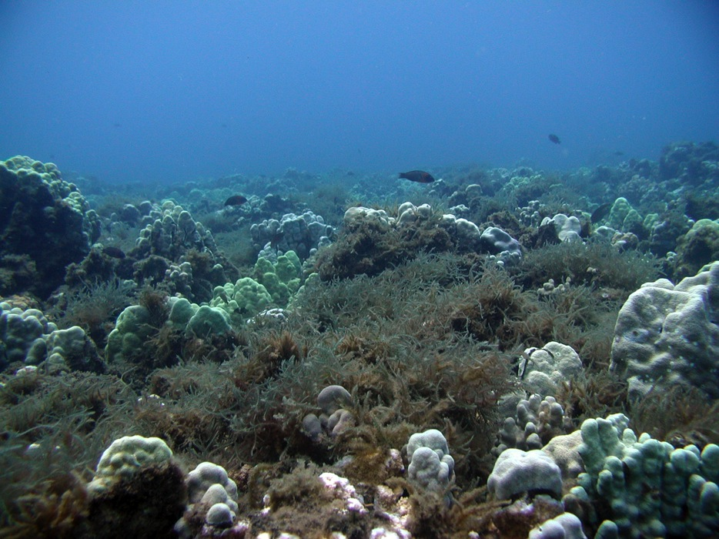
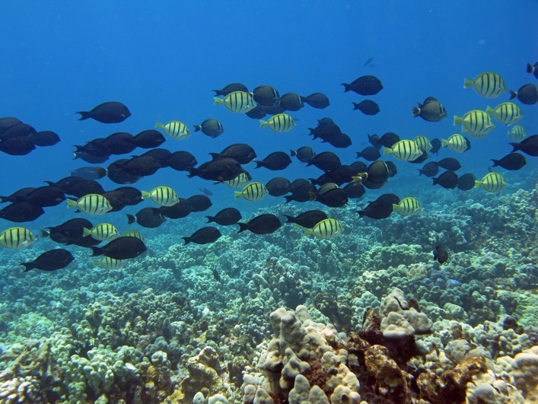
How can we help restore reefs that have undergone or are undergoing a coral to algal phase shift?
Can we develop management strategies to reduce algal abundance and facilitate coral recovery?
Notes:
Given phase shifts on reefs around the world, in this research we ask:
How can we help restore reefs that have undergone or are undergoing a coral to algal phase shift?
And more specifically:
Can we develop management strategies to reduce algal abundance (CLICK) and facilitate coral recovery?

Slide 3
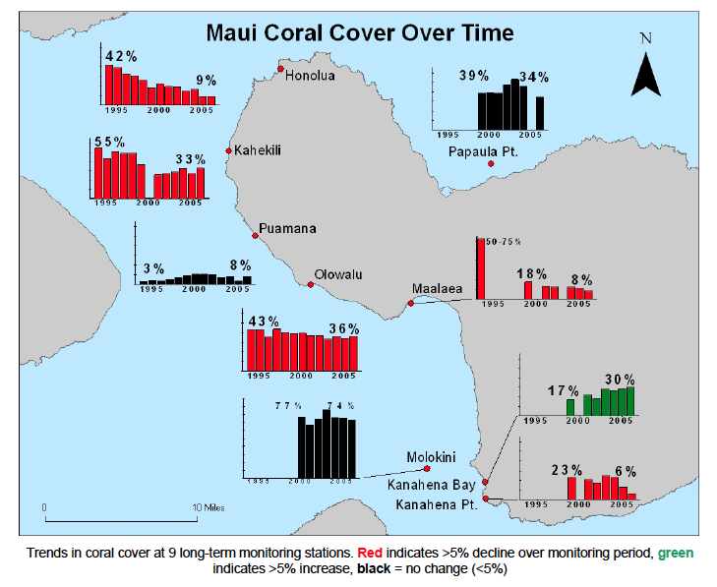
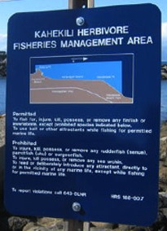
Eric Brown, CRAMP,
DAR and HCRI 2008
Notes:
To help answer these questions, this research was conducted on the island of Maui, where many reefs are experiencing a decline in coral cover. A new management strategy to try to reverse this change was applied to Kahekili reef on West Maui in 2009. Kahekili is now a Herbivore Fisheries Management Area, established in hopes of increasing herbivore biomass to reduce algal cover and restore healthy coral cover on the reef.

Slide 4
Can we balance the budget?
Evaluation of the success of the Kahekili Herbivore Fisheries Management Area (KHFMA)
How much of algal production is being consumed?
By whom?
What are targets for herbivore species and biomass for the future?
Notes:
To evaluate the success of the Herbivore Fisheries Management Area, our work seeks to determine when the budget of production and consumption on the reef is balanced. To do so, we ask:
How much of algal production is being consumed?
By whom?
What are targets for herbivore species and biomass for the future?

Slide 5
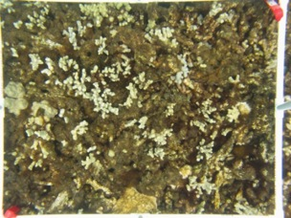
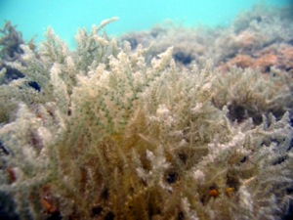
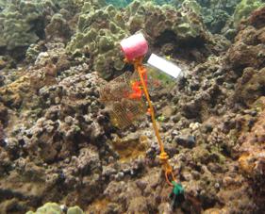
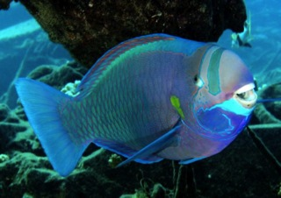
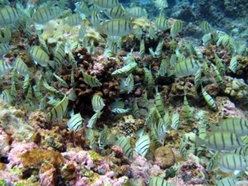
Can we balance the budget?
Benthic community composition
Standing stock of algae
Growth rates of dominant algae
Abundance/biomass of herbivores
Consumption rates of herbivores on different algae
Daily production
< / > / =
Daily consumption
Notes:
Through this work, we’ll ultimately be able to determine how much of daily production is consumed and by whom. This will provide us with targets for the number and type of herbivores that will be needed to control the algal community at Kahekili.

Slide 6
Benthic community composition
Abundance/biomass of herbivores
Consumption rates of herbivores on different algae
Benthic community composition
Standing stock of algae
Standing stock of algae
Growth rates of dominant algae
Growth rates of dominant algae
Daily production
< / > / =
Daily production
Daily consumption
Notes:
Looking at daily production, first we determined benthic community composition

Slide 7
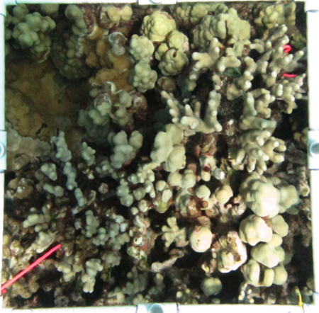
Benthic composition
Notes:
Using benthic photoanalysis and can see that turf algae accounts for almost 50% of benthic cover (CLICK) while macroalgal species in the green boxes (CLICK) make up less than 5%.

Slide 8

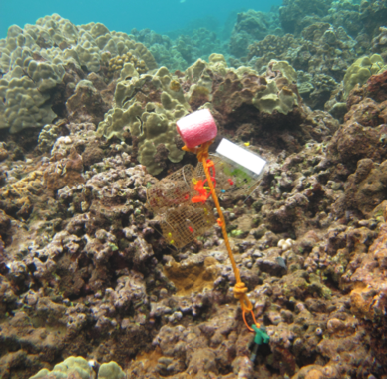
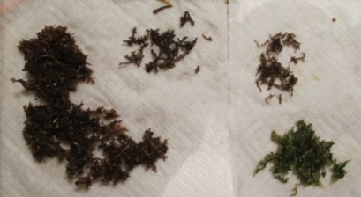
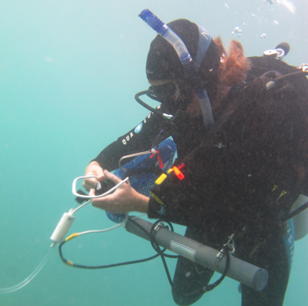
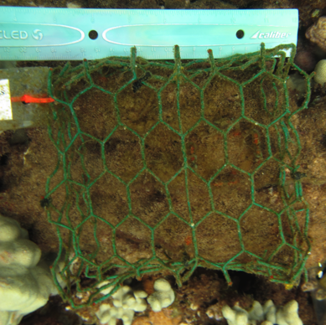
Standing stock biomass
Algal growth
macroalgae
turf
Notes:
We further determined standing stock biomass of macro and turf algae as well as growth rates for each of these functional groups

Slide 9
Turf:
45.57%
Macro:
4.72%
Turf:
24.36 g / m²
Macro:
13.31 g / m²
Turf:
3.77 g/m²/d
Macro:
.14 g/g/d
Benthic community composition
Abundance/biomass of herbivores
Consumption rates of herbivores on different algae
Benthic community composition
Standing stock of algae
Standing stock of algae
Growth rates of dominant algae
Growth rates of dominant algae
Daily production
< / > / =
Daily production
Daily consumption
Turf:
1.72 g / m² / d
Macro:
1.89 g / m² / d
Notes:
To combine with the community composition data to determine the daily production on the reef.

Slide 10
Turf:
45.57%
Macro:
4.72%
Turf:
24.36 g / m²
Macro:
13.31 g / m²
Turf:
3.77 g/m²/d
Macro:
.14 g/g/d
Abundance/biomass of herbivores
Abundance/biomass of herbivores
Consumption rates of herbivores on different algae
Benthic community composition
Standing stock of algae
Growth rates of dominant algae
Consumption rates of herbivores on different algae
Daily production
< / > / =
Daily consumption
Daily consumption
Turf:
1.72 g / m² / d
Macro:
1.89 g / m² / d
Notes:
Next, to examine daily consumption

Slide 11
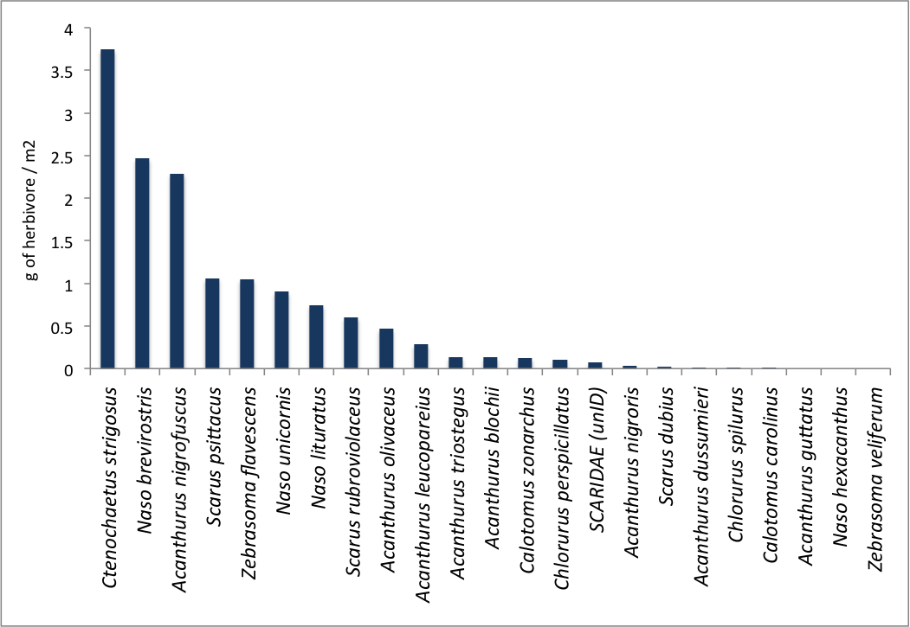
Fish biomass
Notes:
We calculated fish biomass data through surveys across the reef, where Ctenochaetus strigosus and Acanthurus nigrofuscus are some of the most abundant

Slide 12
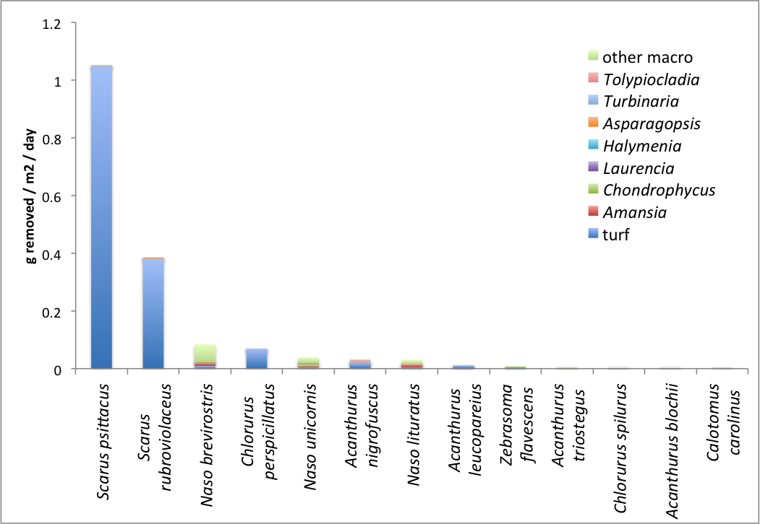
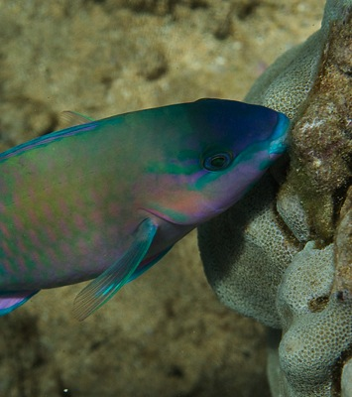
Fish consumption
Photo: Don McLeish
Notes:
And then combining these biomass data with over 500 minutes of observation time results in this figure. First I’d like to highlight that most of these herbivores are consuming turf algae, as would make sense given that almost half the benthic composition is turf. Second- some of the parrotfish on the reef, while not the most abundant, maybe have a disproportionate influence on algae consumption. Finally, you can also see that many of these species have a preference for different species of macroalgae.
Importantly, bite size is still a tricky variable in this calculation and those values have been estimated from the literature and lab experimentation but further work is needed.

Slide 13
Turf:
45.57%
Macro:
4.72%
Turf:
24.36 g / m²
Macro:
13.31 g / m²
Turf:
3.77 g/m²/d
Macro:
.14 g/g/d
Total biomass:
14.25 g / m²
Turf:
8.68 bites / min / g herb
Macro:
0.36 bites / min / g herb
Abundance/biomass of herbivores
Abundance/biomass of herbivores
Consumption rates of herbivores on different algae
Benthic community composition
Standing stock of algae
Growth rates of dominant algae
Consumption rates of herbivores on different algae
Daily production
< / > / =
Daily consumption
Daily consumption
Turf:
1.72 g / m² / d
Macro:
1.89 g / m² / d
Turf:
1.60 g / m² / d
Macro:
0.47 g / m² / d
Notes:
Such that from these calculations we can determine total turf and macroalgal consumption on the reef by the herbivorous fish community.

Slide 14
Turf:
45.57%
Macro:
4.72%
Turf:
24.36 g / m²
Macro:
13.31 g / m²
Turf:
3.77 g/m²/d
Macro:
.14 g/g/d
Total biomass:
14.25 g / m²
Turf:
8.68 bites / min / g herb
Macro:
0.36 bites / min / g herb
Benthic community composition
Standing stock of algae
Growth rates of dominant algae
Abundance/biomass of herbivores
Consumption rates of herbivores on different algae
>
Daily production
Daily consumption
Algae production:
3.62 g/m²/day
Consumption:
2.07 g/m²/day
Notes:
And ultimately, comparing daily production and consumption results in daily production being over one and a half times consumption.

Slide 15
Conclusions
Different species of herbivores have difference preferences for macroalgae, which can be targeted for a given reef
All species dominantly graze turf algae
Increasing biomass over time may shift the balance of production and consumption
Benthic community composition
Standing stock of algae
Growth rates of dominant algae
Abundance/biomass of herbivores
Consumption rates of herbivores on different algae
>
Daily production
Daily consumption
Algae production:
3.62 g/m²/day
Consumption:
2.07 g/m²/day
Notes:
The major conclusions of this work therefore are:
Different species of herbivores have difference preferences for macroalgae, which can be targeted for a given reef
All species dominantly graze turf algae
Increasing biomass over time may shift the balance of production and consumption

Slide 16

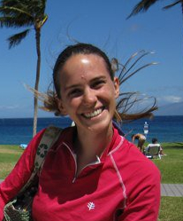
Emily will be at the Coral Reef Systems booth
Wednesday 12:30-4:30
Notes:
Emily’s flight was delayed but she’ll be here this afternoon and will be at the Coral Reef Systems table.

Slide 17
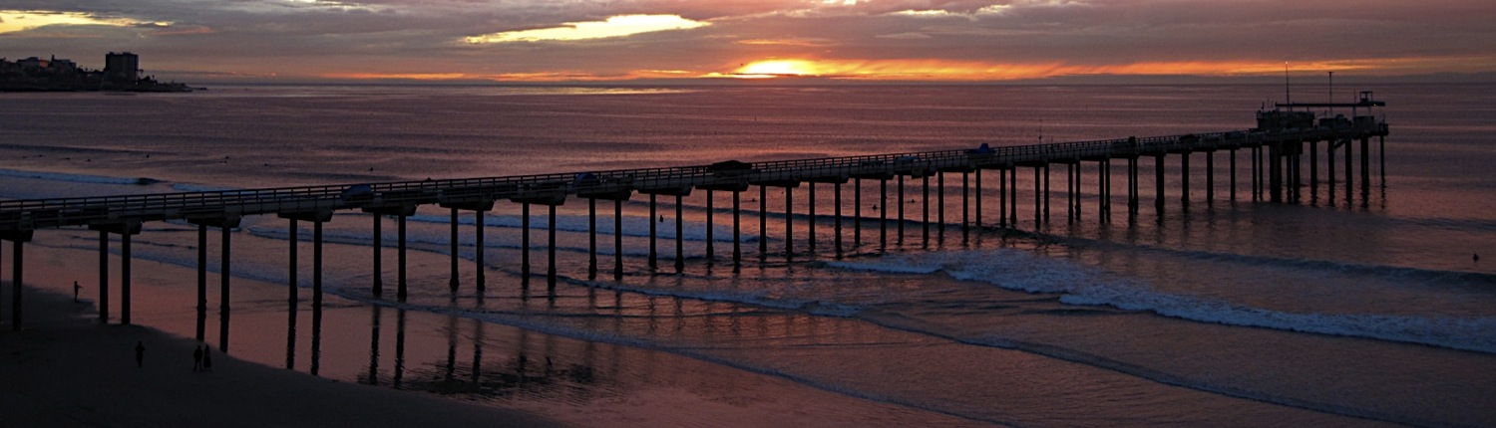








Mahalo / Thank you
Funding provided by:
Center for Marine Biodiversity and Conservation
NSF IGERT
Hawaii Coral Reef Initiative
Edna Bailey Sussman Foundation Fellowship
Explorer’s Fund, Explorers Club
Women Divers Hall of Fame Conservation Scholarship
WWW Foundation / The Rhodes Family
Ursula and David Fairchild
Eloise and Russ Duff
  Elaine Antoniuk
Thank you:
Smith Lab
Sandin Lab
Coral Reef Systems
Meghan Dailer, UH
Darla White, DAR
Penny Dockry
Currie Saray Dugas
Aaron Hartmann
Mariana Luna
Molly Gleason
Samantha Clements
Kevin Moses

